Slide 1

Pandemic and Transformation of automobile industry
Understanding the deep impact of pandemic and future opportunities

Slide 2

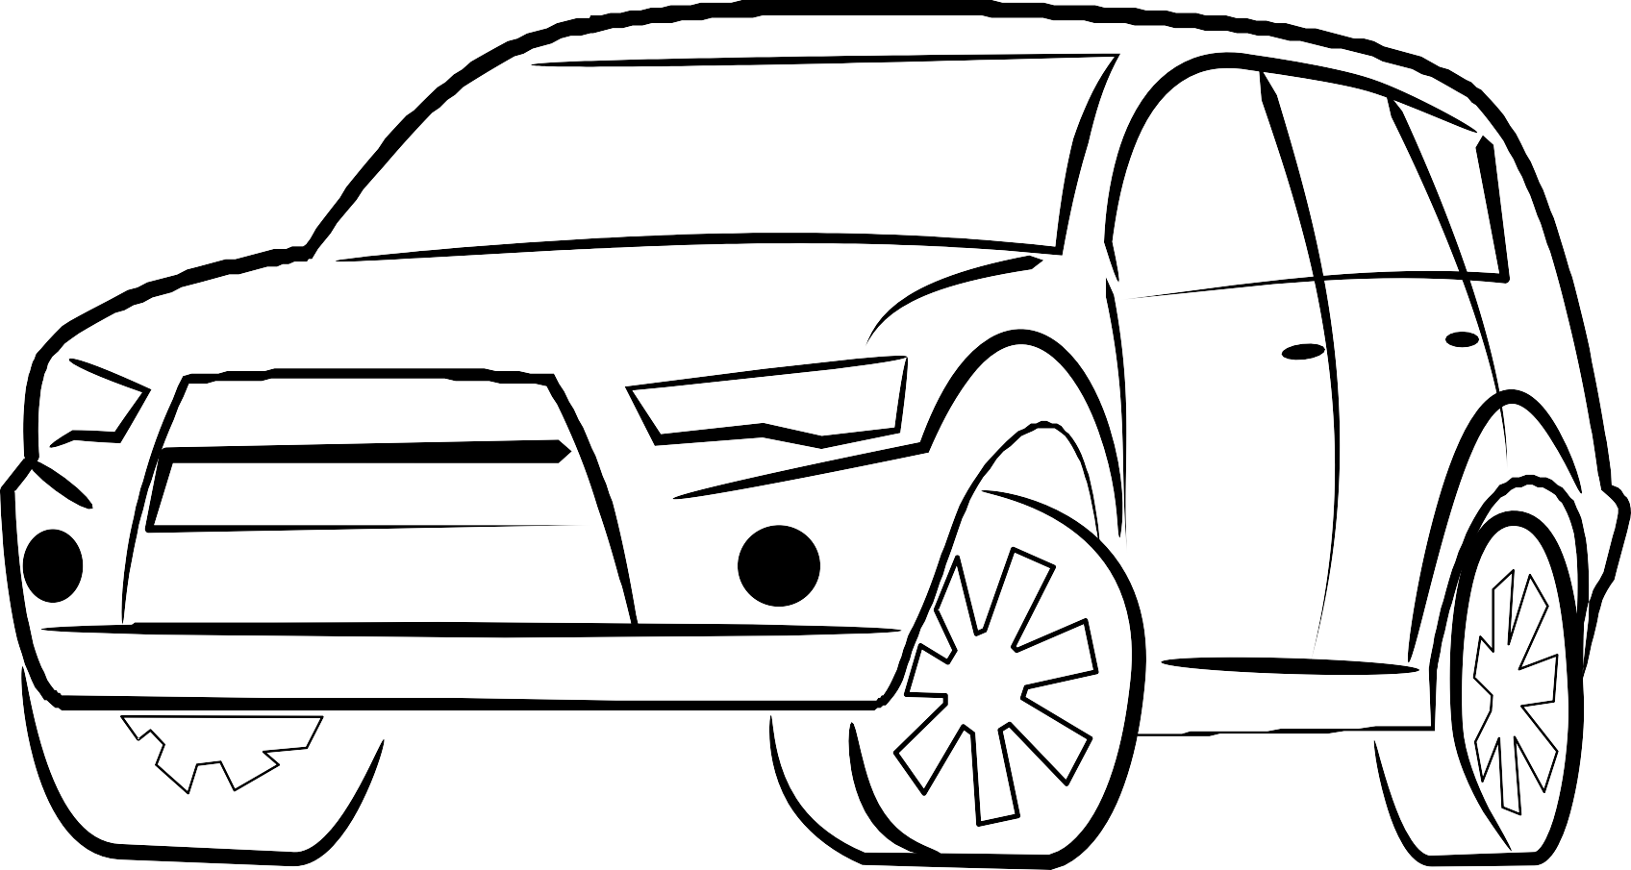
BUSINESS PROBLEM
Automobile industry (04 wheeler) has seen a huge growth with the onset of pandemic.
Leveraging the data from various sources (text/numeric based) the aim is to present a holistic view for the upcoming trends & opportunities for automobile related local businesses.

Slide 3
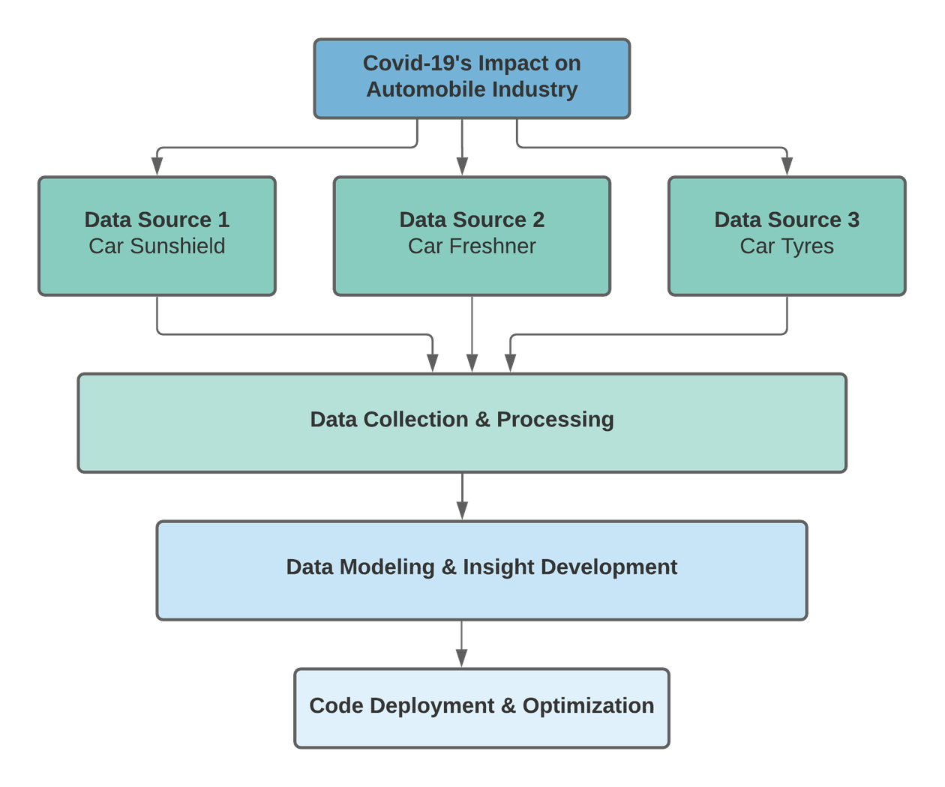
PROCESS FLOW

Slide 4
INITIAL STEPS DEEP DIVE
6
5
4
PRESENT
Insights and story telling
3
PERFRMANCE IMROVEMENT
Analysing the model output and using Agile methodology to improvise the model
2
MODEL BUILDING
Based on the text based data come up with models to define the trends and sentiments
1
EDA
Understanding data and building primary insights using numeric data
DATA
MASSAGING
Cleaning data defining schema
DATA
COLLECTION
The data would be a mixture of textual and numeric data

Slide 5




DATA COLLECTION PROCESS
Sources and methods
NUMERIC DATA
TEXT DATA
Social media, Amazon reviews E-commerce Data Web imprints
Sales Revenue Profits
METHODS USED
Using selenium, Bs4, Scrapy and API (tweepy)

Slide 6
DATA MODELLING AND INSIGHTS
We will be dealing with two types of data text based and numeric data
The numeric data will be backed with facts and sentiments from out text analysis
With the combination of sentiment analysis and topic modelling we will be developing our insights
Methods which we intend to use:
Univariate/ Bivariate regression
NLP (Natural language Processing), Text summarisation EDA - Correlation analysis

